Slide 1

TRAVEL AND TOURISM
S.NO | NAME | ROLL NUMBER
1 | SAI VAMSHI | 2110030296
2 | B. SAI KISHORE | 2110030316
3 | BADE ASHRITH | 2110030329
4 | BHARGAVRAJ | 2110030342
5 | B. AKSHAYA | 2110030345

Slide 2
Table of contents
01
02
03
04
05
Introduction
Problem Statement
Solution Breakdown
Implementation
Conclusion

Slide 3
INTRODUCTION
The travel and tourism domain encompasses a wide range of activities and industries related to leisure, business, and cultural exploration.
It plays a significant role in global economies, driving employment, infrastructure development, and cultural exchange.

Slide 4
PROBLEM STATEMENT
Travelers today struggle with planning efficient trips due to three key limitations:
Lack the ability to optimize their itineraries, often cramming too much or missing out on must-see experiences.
Current planning methods make it difficult to stay within budget, leading to unexpected costs.
Finally, tourists often miss out on the unique and authentic experiences offered by "hidden gems" because they are unaware of these options.

Slide 5
SOLUTION BREAKDOWN
Our tourism app is designed to enhance your travel experience by providing a comprehensive plan of action for your duration in a destination. Through a series of carefully curated tasks, you'll explore all the must-visit places and hidden gems, ensuring you make the most of your time.
Benefits:
Smart Budgeting
Maximized Experience & Efficiency
Discovery & Local Flavor

Slide 6

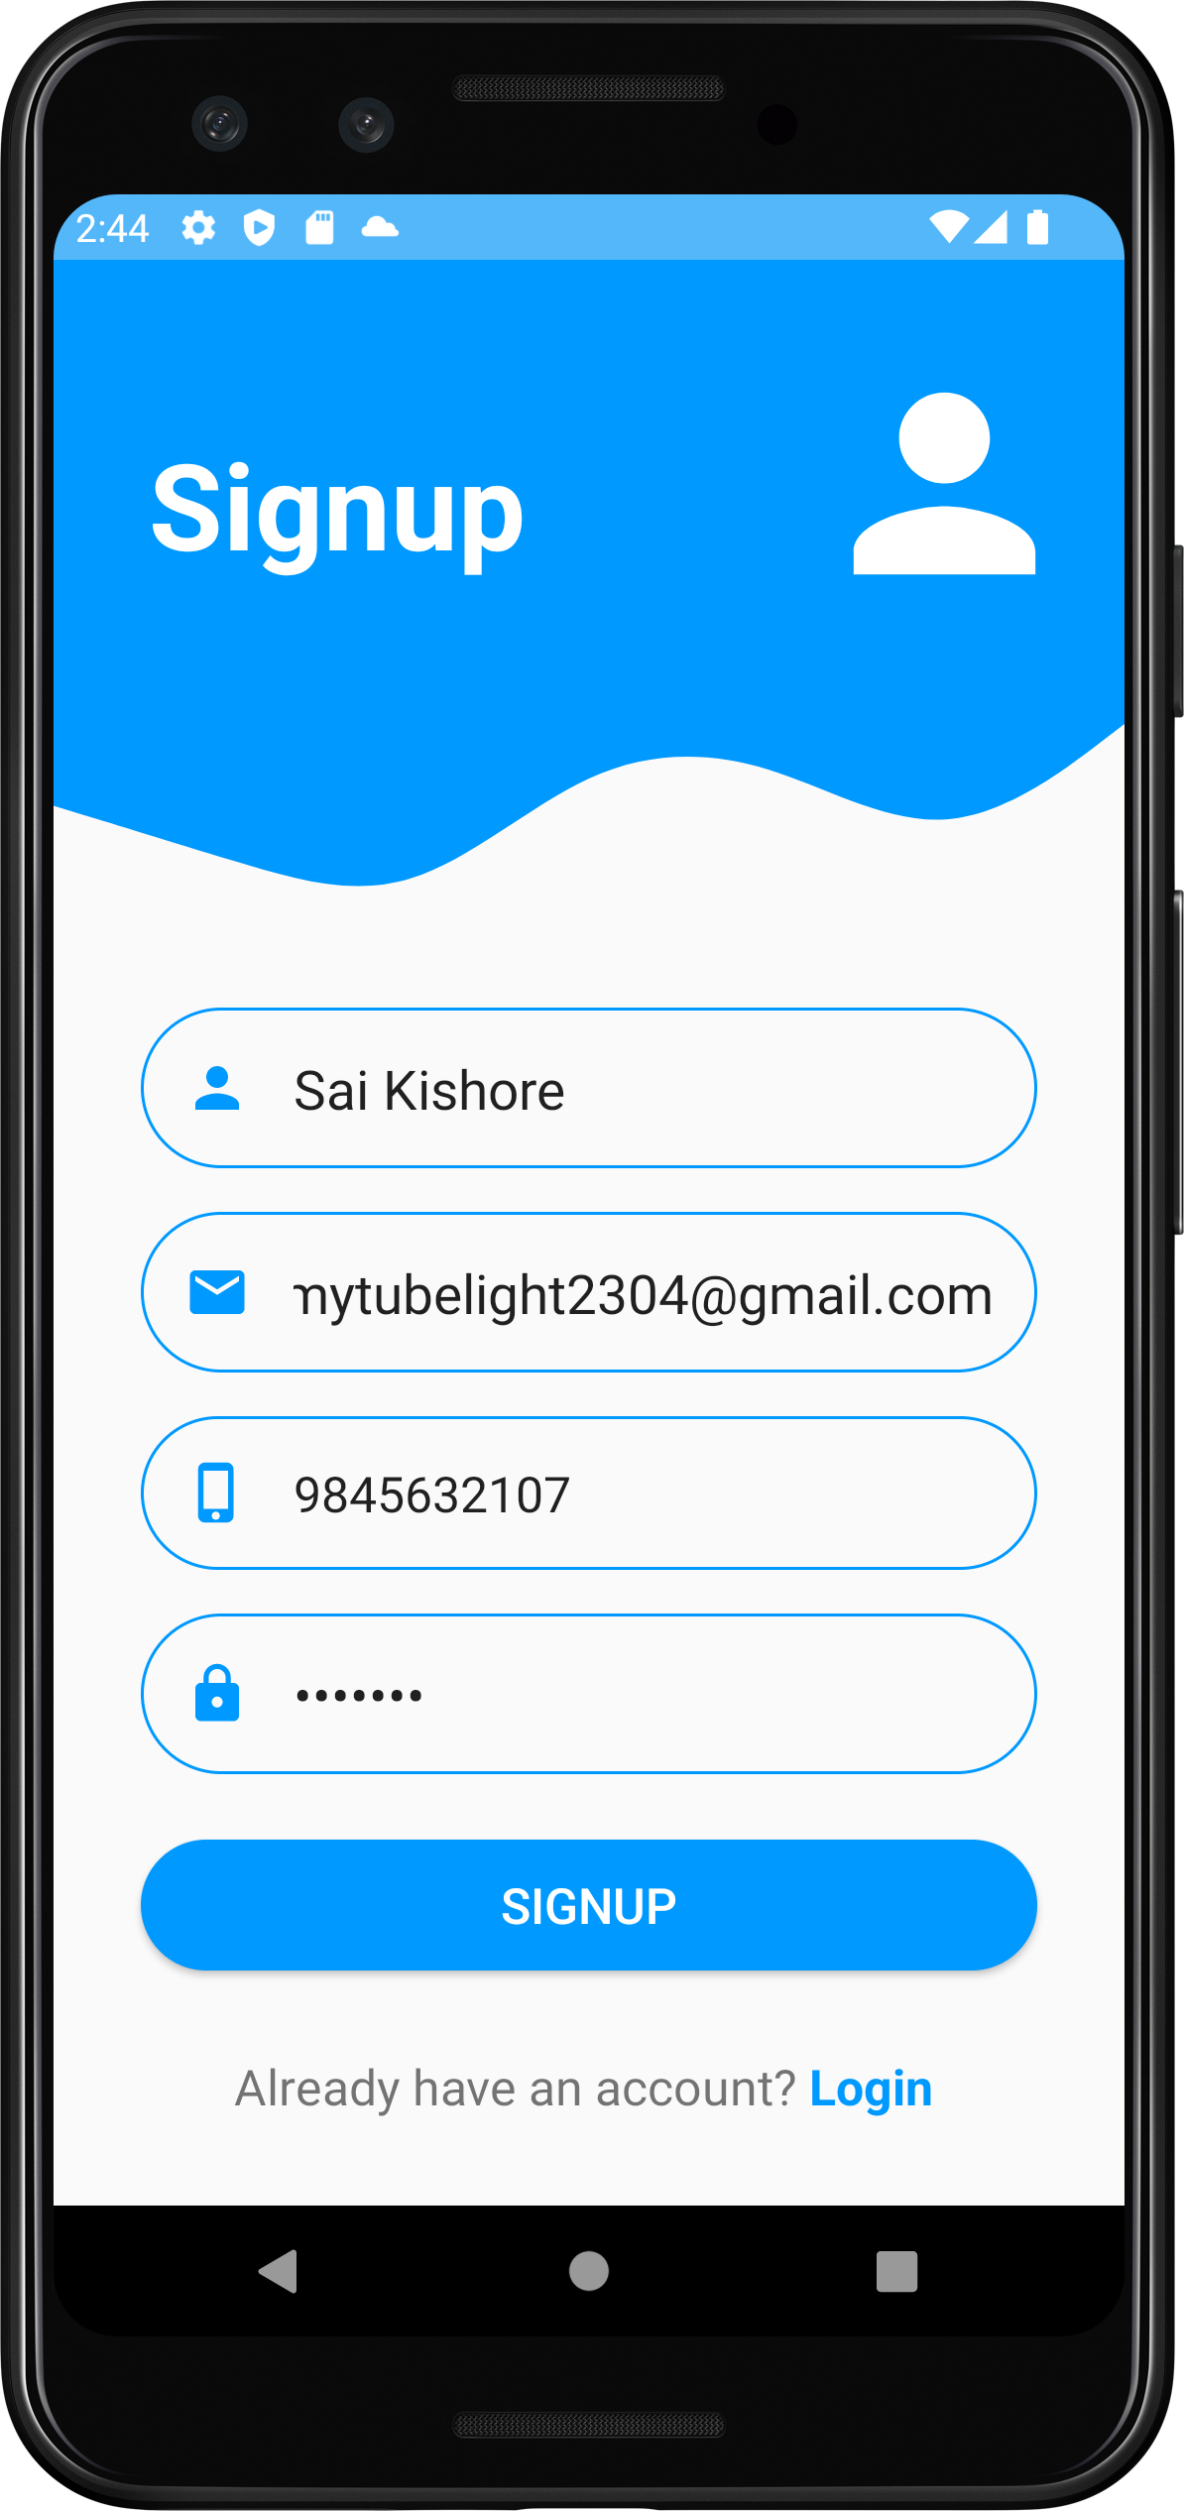
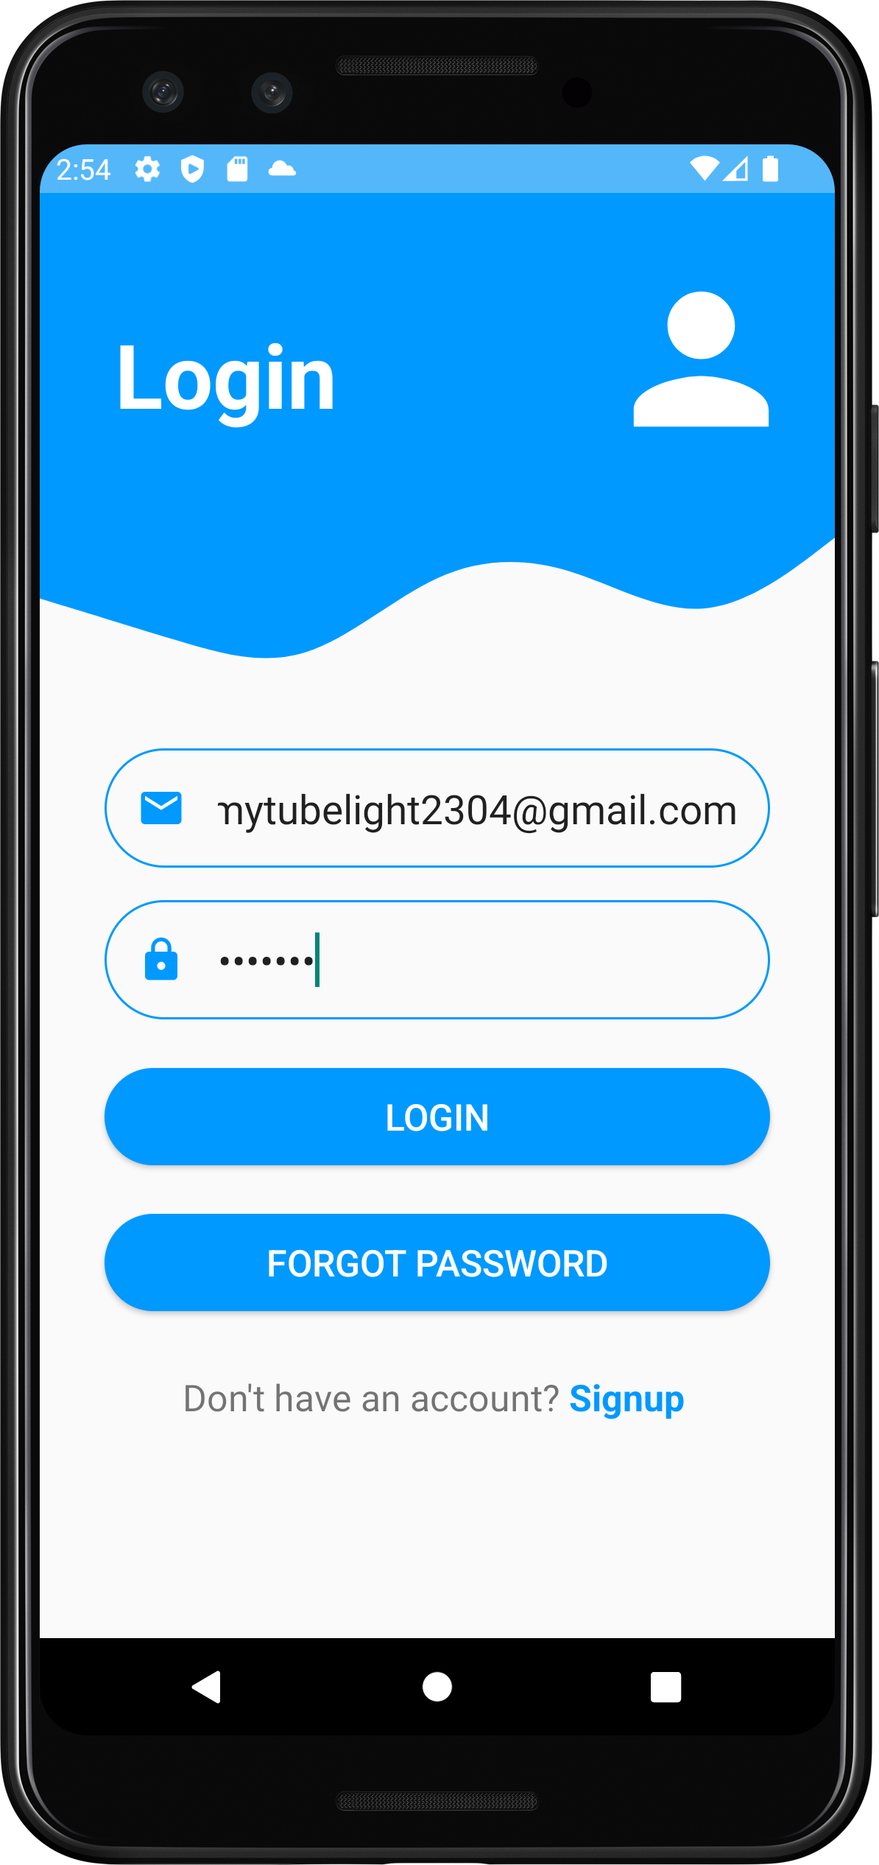


Slide 7

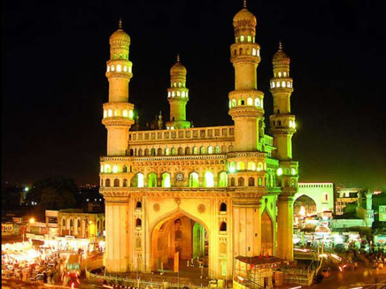
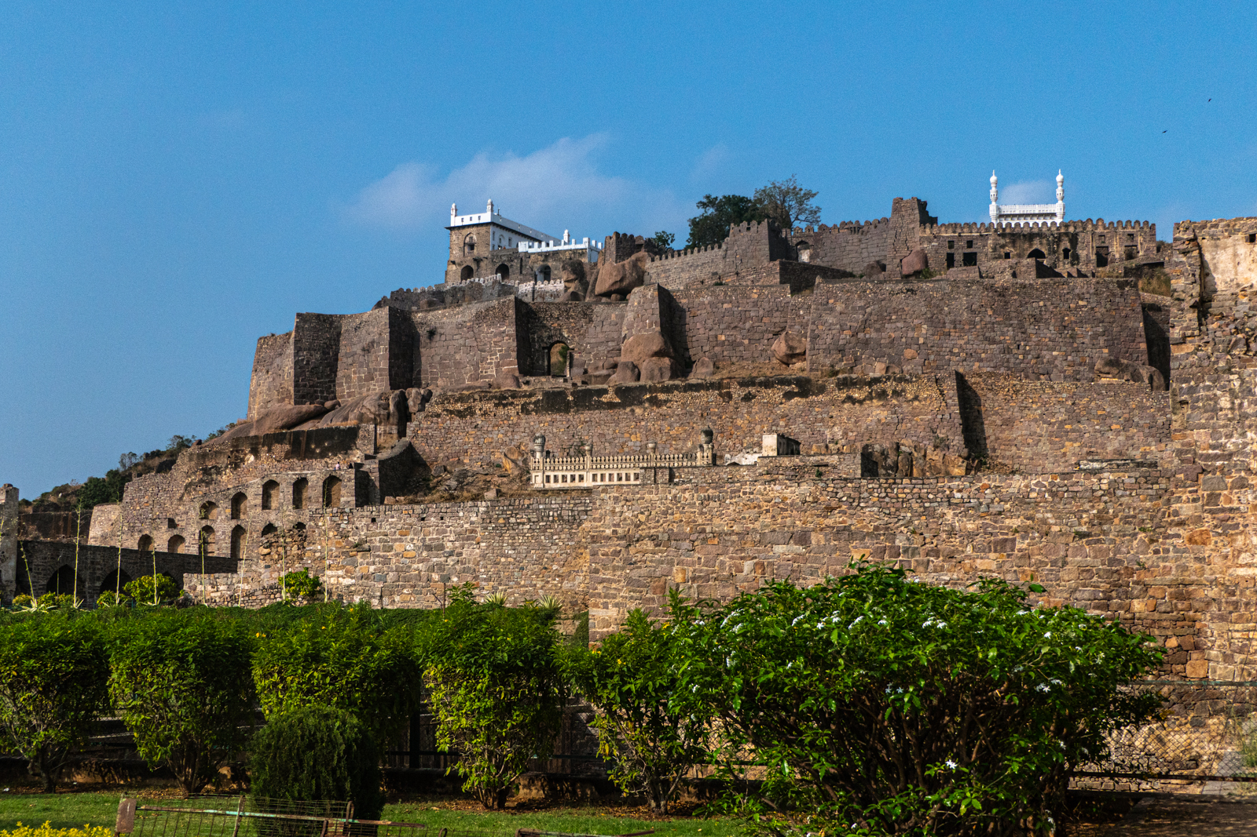
10
Select a category:
Select a Location:
Hyderabad
Family
Days
Number of Days :
Select places:
Friends
10
Charminar
Couple
NEXT->
Solo
Golconda

Slide 8
Task to be accomplished
Day 1
Charminar
Day 1
Visitors Interest
Day 2
Min Places-3
Golconda
Max Places-5
Day 3
Day 2
Tasks
Wonderla
Min Places-3
Max Places-5

Slide 9


Status
Voucher
Claim Coins
Unlock

Slide 10


Additional Features:
Connecting residents nearby

Slide 11
IMPLEMENTATION
Start:
The app launches.
Sign Up / Login:
The user either signs up for a new account or logs in to an existing one.
Enter Trip Details:
They provide information about their trip: number of days, preferred places to visit, and interests.
Generate Plan:
The app uses the trip details to generate a personalized plan with tasks (places to visit, restaurants to try) based on the user's preferences, ensuring enough activities are included for the trip duration. The estimated time for each task and the entire trip is calculated.
Update Coin Count:
The user's total coin balance is updated.
Check Coin Balance (End of Day/Trip?):
At the end of the day or trip (based on the user's actions), the app checks the user's coin balance.
Offer Voucher (Coins Available):
If the user has enough coins to qualify for a voucher tier, the app offers them a voucher.
Thank You (End):
The app displays a "Thank You" message for using the app.
Display Plan: The user sees the generated plan, which includes a list of tasks with estimated times.
Complete Task (User Starts Task): When the user starts or completes a task (e.g., visits a place or eats at a restaurant), they can mark it as done in the app.
Complete Task (Successful): If the task is marked as done successfully, the user receives coins as a reward.
Claim Coins: Coins are automatically claimed after successful task completion.

Slide 12
CONCLUSION
This user-centric approach enhances travel planning and encourages active engagement with the app, resulting in a satisfying and rewarding experience.
Our innovative tourism app solves your problems with a data-driven approach, ensuring a maximized, budget-friendly, and discovery-rich experience.

Slide 13


